Slide 1
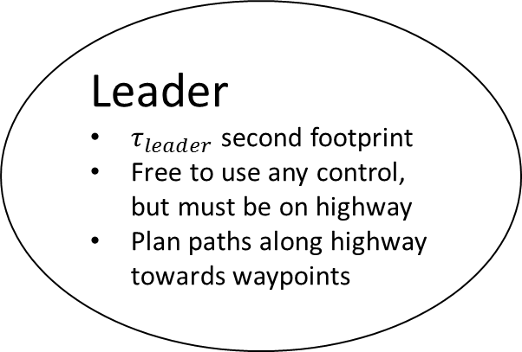
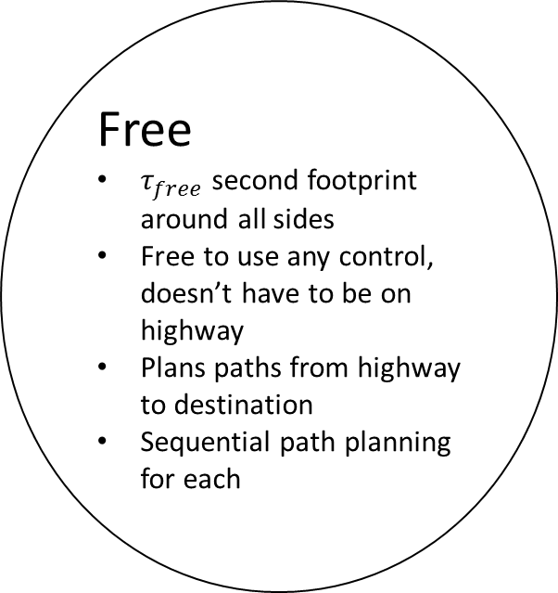
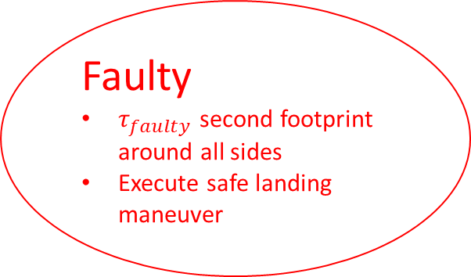
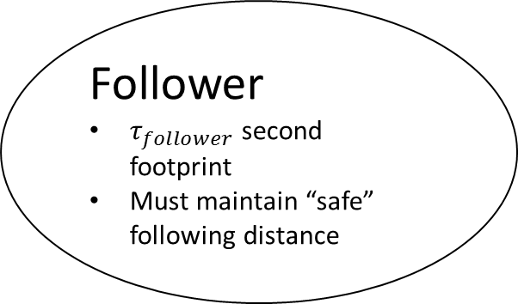
Vehicle operation modes
Leave group
Leader
$τ_{leader}$ second footprint
Free to use any control, but must be on highway
Plan paths along highway towards waypoints
Promote
Join group
Create group
Free
$τ_{free}$ second footprint around all sides
Free to use any control, doesn’t have to be on highway
Plans paths from highway to destination
Sequential path planning for each
Follower
$τ_{follower}$ second footprint
Must maintain “safe” following distance
Join group
Leave group
Faulty
$τ_{faulty}$ second footprint around all sides
Execute safe landing maneuver
(Zoom in or go to next slide to see text inside bubbles)

Slide 2
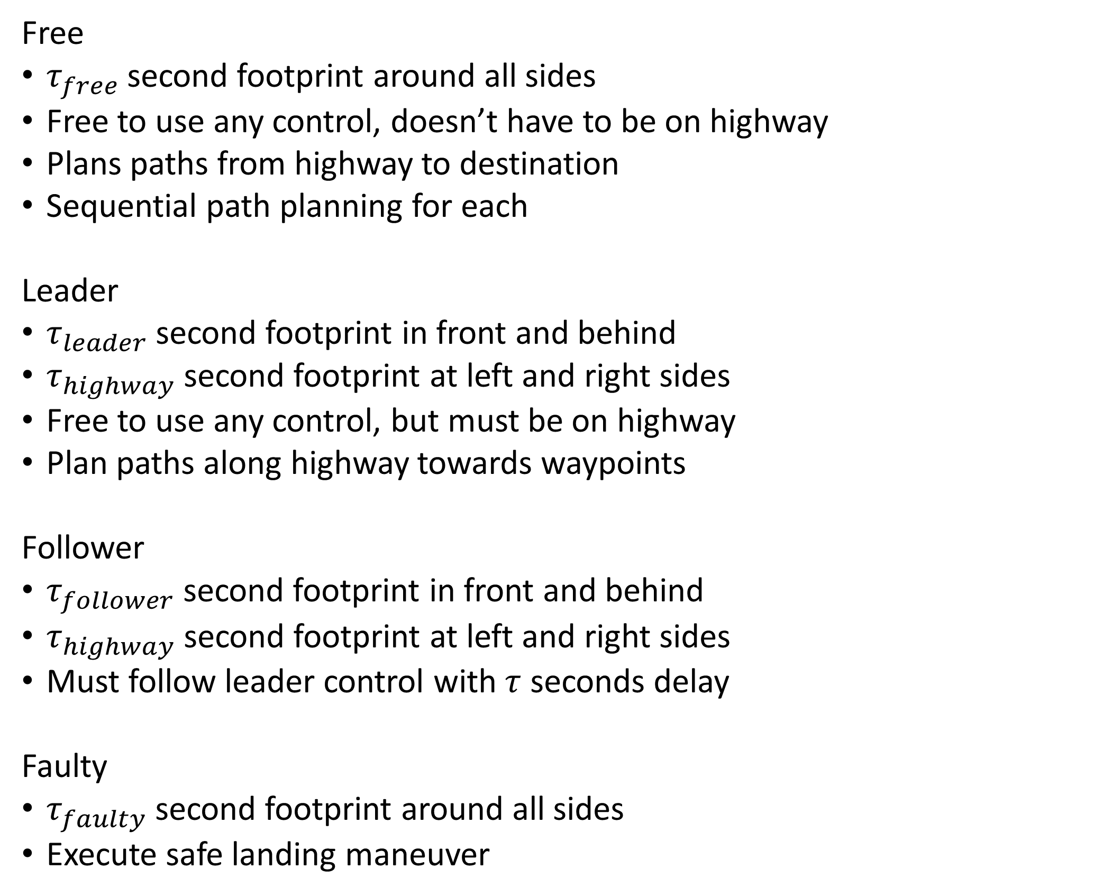
Free
$τ_{free}$ second footprint around all sides
Free to use any control, doesn’t have to be on highway
Plans paths from highway to destination
Sequential path planning for each
Leader
$τ_{leader}$ second footprint in front and behind
$τ_{highway}$ second footprint at left and right sides
Free to use any control, but must be on highway
Plan paths along highway towards waypoints
Follower
$τ_{follower}$ second footprint in front and behind
$τ_{highway}$ second footprint at left and right sides
Must follow leader control with $τ$ seconds delay
Faulty
$τ_{faulty}$ second footprint around all sides
Execute safe landing maneuver

Slide 3
Group States
Number of members
Footprint (depends on number of members)
Formula derived from reachability calculations
Dynamics (assume same dynamics for all vehicles for now)
Group functions
Join another group
Current group ceases to exist
Assimilate another group
Number of members and footprint increase
Discharge members of the group
Number of members and footprint decrease
Join
Assimilate
(Disbanded)
Group
Discharge

Slide 4
Performance evaluation
Comparison with “baseline”
What baseline?
What criteria?
Throughput
“Safety level”
Worst case delay

Slide 5
Leave highway
Follow highway
Leader
Leader of platoon
Create new platoon
Merge onto highway
Follow platoon
Merge with platoon in front
Free:
Vehicle not in a platoon or on a highway
Follower
Member of platoon
Join platoon
Leave highway
Faulty
Descends after 2 seconds

